Slide 1
Examination of Fungi Species Found in Naturally Infected Agar Wood from Some Localities of Myanmar
Wai Wai Than
Senior Researcher
FRI
MYANMAR

Slide 2
Contents
Introduction
Literature Reviews
Materials and Methods
Results
Discussions & Conclusions
Recommendations
2
3
4

Slide 3
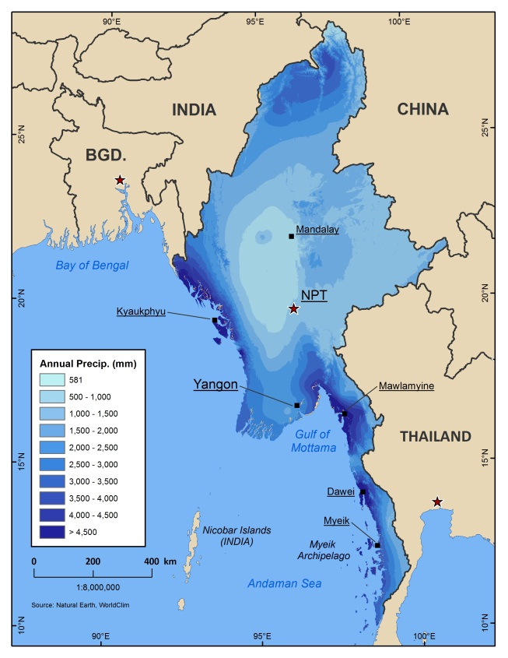
Myanmar

Slide 4
Major Forest Types, FRA 2010.

Slide 5
Introduction
Aquilaria tree; Agar tree, Eagle wood
10- 15 species
Family -Thymelaeaceae
Aquilaria malaccensis Lamk. ; DC.Prod.
syn. A. agallocha Roxb. naturally growing in Myanmar
Evergreen tree, 15 m - 40 m in height
Tanninthayi Region, Kachin State, and Upper Chindwin

Slide 6
Introduction cont.
It grows on well drained soils, shallow soils over rocky beds, on hill slopes and forest environment
except paddy field and swamp (Indian literatures & websites) (M M Than & C Doo, 1977).
About 7-10 years old, the trunk is attacked by fungi through natural holes or injuries and chemical reactions inside the tree trunk, oleoresin is produced (TREECD 1973-99/07).

Slide 7
Literature Review
Warm and high humid sub-tropical climate
Annual rainfall ranging from 1800-3500 mm
(70.87 in- 137.80 in) (Indian literatures)
1200 - 2000 mm (47.25 – 78.74 in) (M M Than & C Doo, 1977).
Average temperature 18- 32 ̊C; (M M Than & C Doo, 1977).
Altitude (500- 1000 m =1640.42 – 3280.84 ft.) (The Rainforest Project Foundation, 2002).,
about 100 – 1000 m = 300 ft-3000 ft (M M Than & C Doo, 1977).

Slide 8
Literature Review cont.
Fungi Infection
Infected with fungi become an aromatic resin in response to this attack.
Symptom
Its uninfected wood of the tree is light in color
Initial stage infection appears as brown streaks in the tissue
Infected pieces of agar wood changing its color from a pale to dark brown or black, and high density
(Indian Agar wood, 2010)

Slide 9
Literature Review cont. Fungi Infection cont.
The fungi that enter the tree trunk
Class- Ascomycetes, Deuteromycetes,
Species- Aspergillus sp., Botryodiplodia theobromae;
Cytospherae magniferae; Diplodia; Epicoccum granulatum;
Phomopsis aquillariae; (TREECD 1973-99/07);
Class e.g., Deuteromycetes , Ascomycetes , Basidiomycetes
Species- Phialophora parasitica, Torula sp., Aspergillus sp.,
Penicillium sp., Fusarium sp., Cladosporium sp., Epicoccum granulatum, Cylimndrocladium sp., Sphaeropsis sp., Botryodiplodia theobromae, Trichoderma sp., Phomopsis sp., and Cunninghamella echinulata,
(Blanchette, Robert A. 2005).

Slide 10
Problem Statement
High economic value is one of the reasons to over exploitation of natural agar tree
Stock becoming reduce, therefore, in these decades, agar wood plantation was initiated in Asia as well as in Myanmar
In natural forest, only about 7% of the trees was infected by the fungus, it is needed to inoculate for infection;
Necessary to produce stimulate agents for oleoresin production for mass production and expect going to commercial market

Slide 11
Objectives
To record infected fungi from natural agar wood from some parts of Myanmar
To produce stimulate agents for inoculation to planted agar tree
To induce mass production of oleoresin from planted agar tree

Slide 12
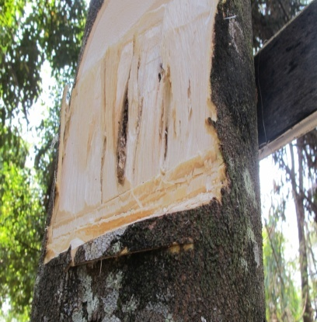
Materials and Methods
Samples collections
Bodaung Reserve Forest, Compartment 17, Myaik, wood samples of Boakpyin,Tanninthayi Region; and
Agar tree of Home Garden, Myitkyina, Kachin State; wood sample from Tant Yunn, Shan State

Slide 13
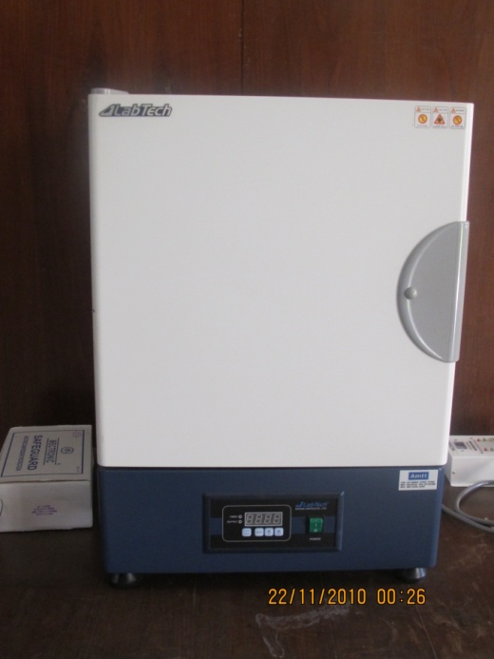
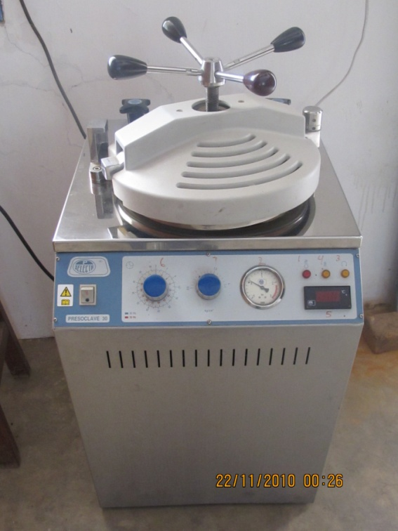
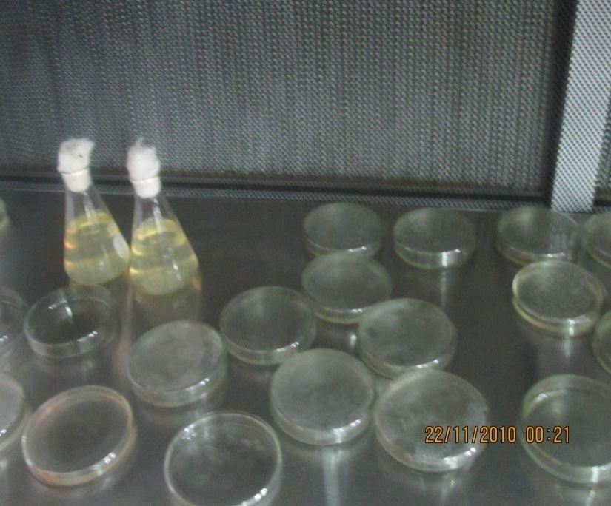
Materials and Method cont.
laboratory tests:
Media (nutrient for fungi) preparation

Slide 14
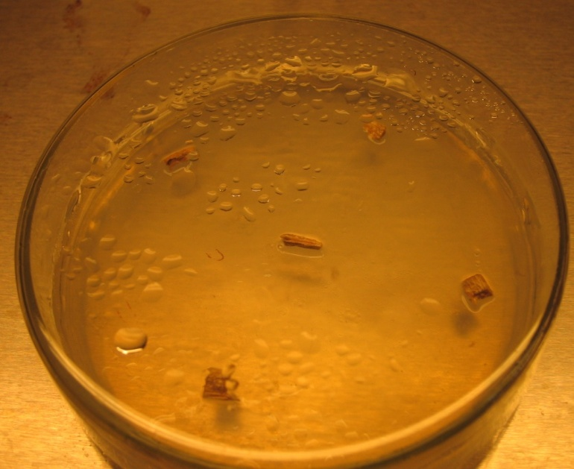
Materials and Method cont.
laboratory tests:
Research Procedures
Cutting and sterilization the fungi infected wood
Isolation into PDA plate(Potato Dextrose Agar)
Transfer into test tubes for pure culture
Monitoring spores (reproductive structures) formation
Slide preparation

Slide 15
Identification
Study the microscopic structures
Photographic record
Identification of infected fungi
(refer to Alexopoulos & Mims,1979 Introductory Mycology; and Barnett & Hunter, 1972. Illustrated Genera of Imperfect Fungi.)

Slide 16
Results
Myeik
Climatic conditions (2001-2011 )
Temperature 21.99 – 31.23 ˚C
Rain fall: 164.48 in
Altitude 20 ft
Myitkyina
Climatic conditions (2001-2011 )
Temperature 18.8 – 30.5 ˚C
Rain fall: 95.99 in
Altitude 476 ft

Slide 17
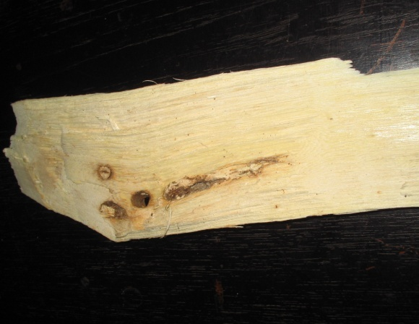
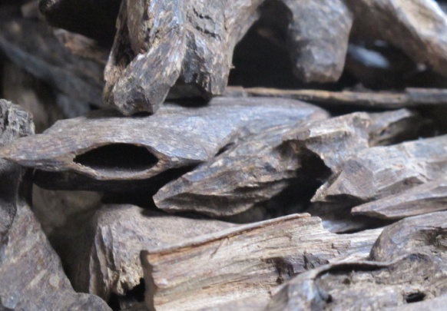
Results cont. Symptom
Infected wood (initial stage)
Infected pieces of agar wood (market stage)
light color wood
brown streaks in the wood tissue
grey and dark in color
heavier than uninfected wood
Smell and oily

Slide 18
Table 1. Fungi from infected agar wood of Myeik
No. | Source | Family | Genera | Tree size (ft.) | Age
1. | Myeik, tree 35 Bodaung | Dematiaceae | Curvularia sp | Ht. 25, Girth 1.6 | About 7 yrs
2. | Myeik, Tree 39 Bodaung | ͈ | Curvularia sp. | Ht. 35, Girth 1.5 | ͈
3. | Myeik, tree (owner U Than Myint) | Tuberculariaceae | Fusarium sp. | Ht. 65, Girth 3 | About 20 -25 yrs
4. | ͈ | Sphaeropsidaceae | Leptosphaeria sp. | ͈ | ͈

Slide 19
5. | Myeik, wood | Dematiaceae/ Moniliaceae | Alternaria sp.
6. | Boakpyin, wood | “ | Alternaria sp.
7. | “ | Eurotiaceae/ Moniliaceae | Aspergillus sp.
8. | “ | Tuberculariaceae | Fusarium sp.
9. | Injected oil | Ascosphaeraceae | Ascosphaera apis |  | Mawkun company

Slide 20
Table 2. Fungi from infected agar wood of Myitkyina and wood from Tant Yunn
No. | Source | Family | Genera | Tree size (ft.) | Age
1. | Myitkyina, tree | Eurotiaceae/ Moniliaceae | Aspergillus sp. | Ht. 40, Girth 3.5 | About 20-23 yrs
2. | Myitkyina, tree | Tuberculariaceae | Fusarium sp. | ͈ | ͈
3. | Tant Yunn, wood | Nectriaceae | Nectria sp.

Slide 21
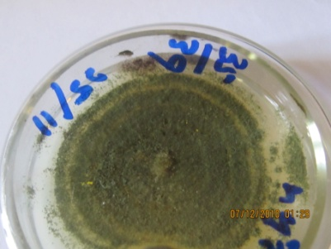
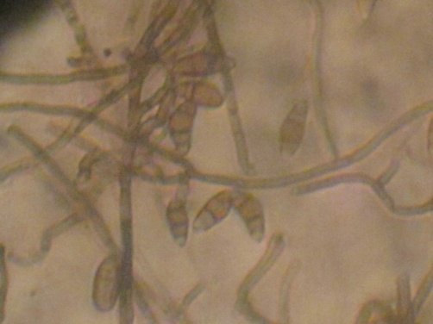
Curvularia sp. Myeik

Slide 22
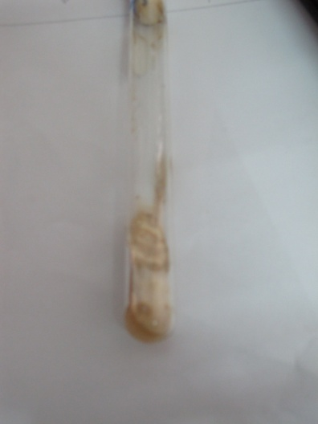
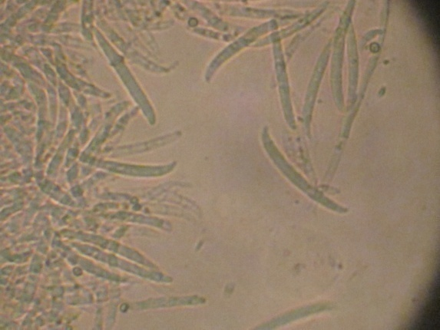
Fusarium sp. (Myeik)

Slide 23
Leptosphaeria sp. (Myeik)

Slide 24
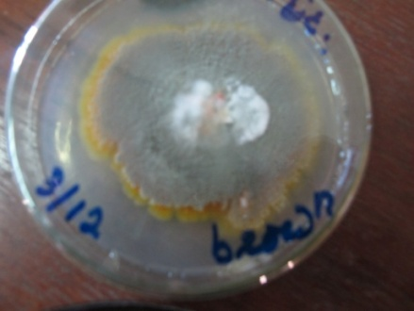
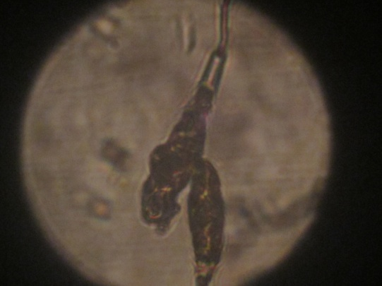
Fungus Alternaria sp. Myeik & Boakpyin

Slide 25
Aspergillus sp. Boakpyin

Slide 26
Fusarium sp Boakpyin

Slide 27
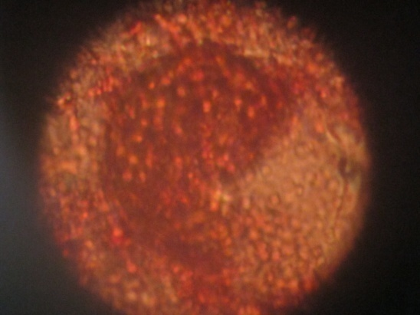
Injected fungi Ascosphaera apis (Myeik)
Spore balls and spores
Injected fungi culture
(Mawkun Company)

Slide 28
Aspergillus sp. Myitkyina

Slide 29
Fusarium sp. Myitkyina

Slide 30
Nectria; Fusarium
Tant Yunn

Slide 31
Discussions & Conclusions
Symptom of agar wood infection in Myanmar is similar to the literatures cited
Climatic conditions
Temperature of Myeik and Myitkyina were not too different to the literatures
Rainfall of Myeik was more and
Altitude of Myeik is lower than descriptions of the literatures

Slide 32
Discussions & Conclusions cont.
In the present fungi list, two species Aspergillus sp. and Fusarium sp. are same to the literatures
Root rot disease of a planted agar tree (3 years old) occurred in Myitkyina in 2011 (Wai Wai Than, 2011)
In the list of present fungi (table 1 & 2) , Fusarium was found in the infected agar wood thus observations have a contrast the fungi disease in the roots to be die the tree, cause of the fungi blocking in xylem, however, the fungi is possible agent to oleoresin producing from the stem wood response chemical reaction and Fusarium is faster infected fungi than other(Indian Agar wood, 2010).

Slide 33
Discussions & Conclusions
It cannot be concluded definitely that these fungi are agents to oleoresin producing, other important factors such as environmental conditions, host and natural consequence happenings are including to be considered
However, the findings can be approached to make more searching artificial stimulate agents for production of the oleoresin

Slide 34
Recommendations
Mechanisms of the fungi infection, observation of the fungi and tree response, chemical reaction and resin production are not easy to understand
However; Plant Physiologist and Mycologist need to study the mechanisms by using advance tools and technologies in the future
International cooperation is also necessary for the systematic technologies, commercial production and marketing with experts to nurture a new generation

Slide 35
Ironing & Injection in Myitkyina

Slide 36
Marking for drilling on the agar tree in Myeik

Slide 37
Injection 1 & 2 in Myeik

Slide 38
Open the drilled hole

Slide 39
Aquilaria Subintegra", found in Thailand *"Aquilaria Crassna" found in Malaysia, Thailand, and Cambodia *"Aquilaria Malaccensis", found in Malaysia, Thailand, and India *"Aquilaria Apiculina", found in Philippines *"Aquilaria Baillonil", found in Thailand and Cambodia *"Aquilaria Baneonsis", found in Vietnam *"Aquilaria Beccarain", found in Indonesia *"Aquilaria Brachyantha", found in Malaysia *"Aquilaria Cumingiana", found in Indonesia and Malaysia *"Aquilaria Filaria", found in China *"Aquilaria Grandiflora", found in China *"Aquilaria Hilata", found in Indonesia and Malaysia *"Aquilaria Khasiana", found in India *"Aquilaria Microcapa", found in Indonesia and Malaysia *"Aquilaria Rostrata", found in Malaysia *"Aquilaria Sinensis", found in China

Slide 40
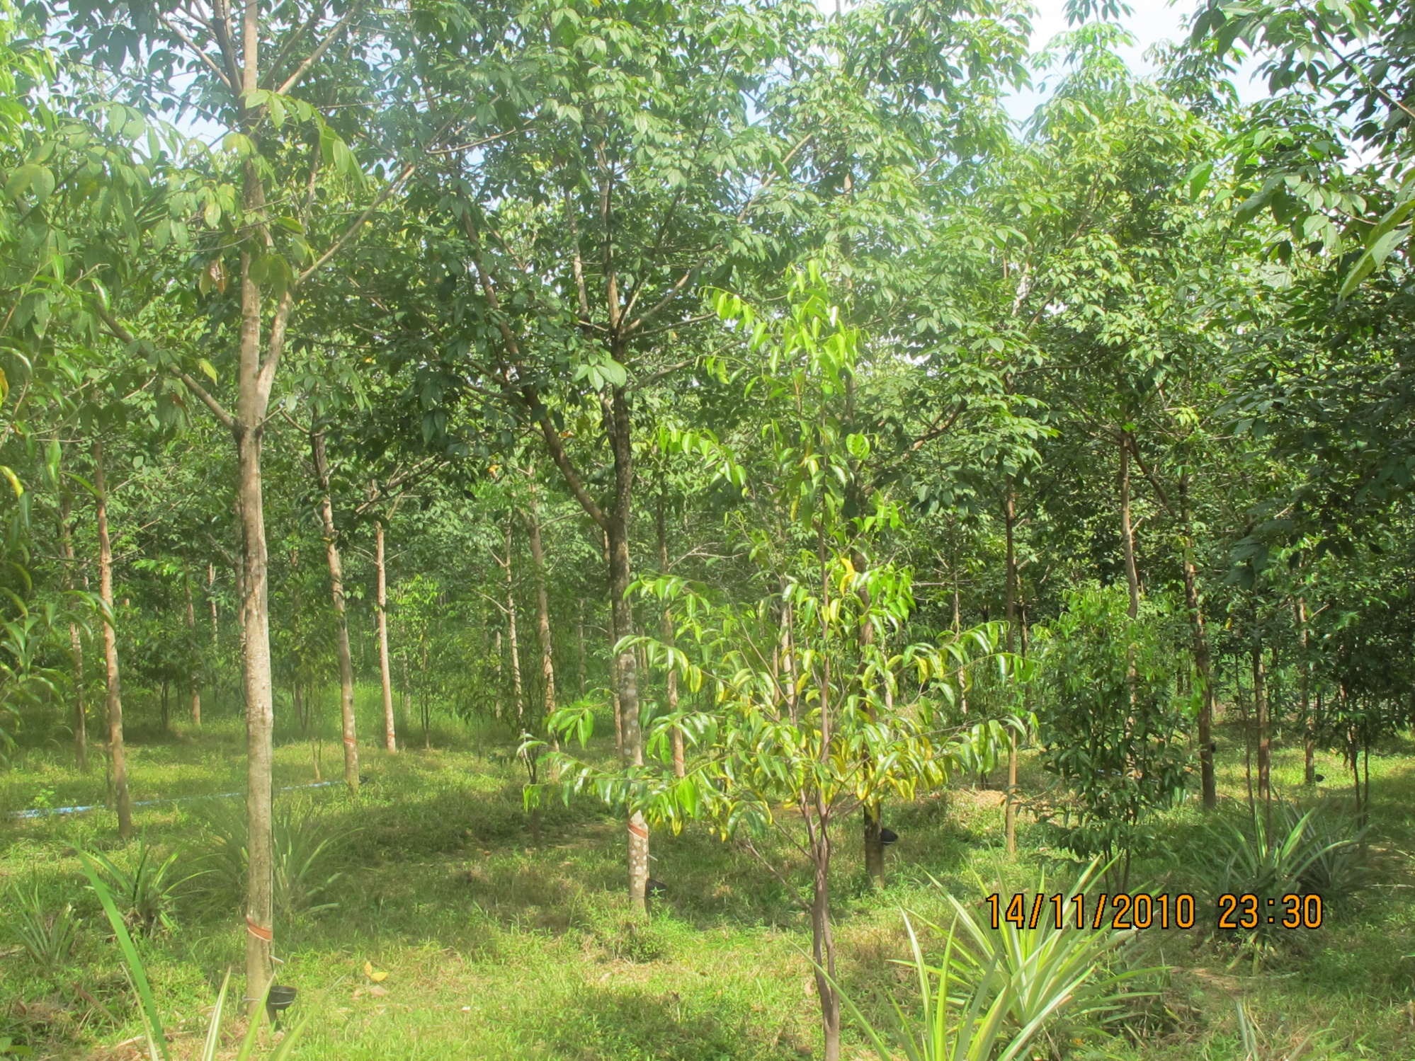

Slide 41
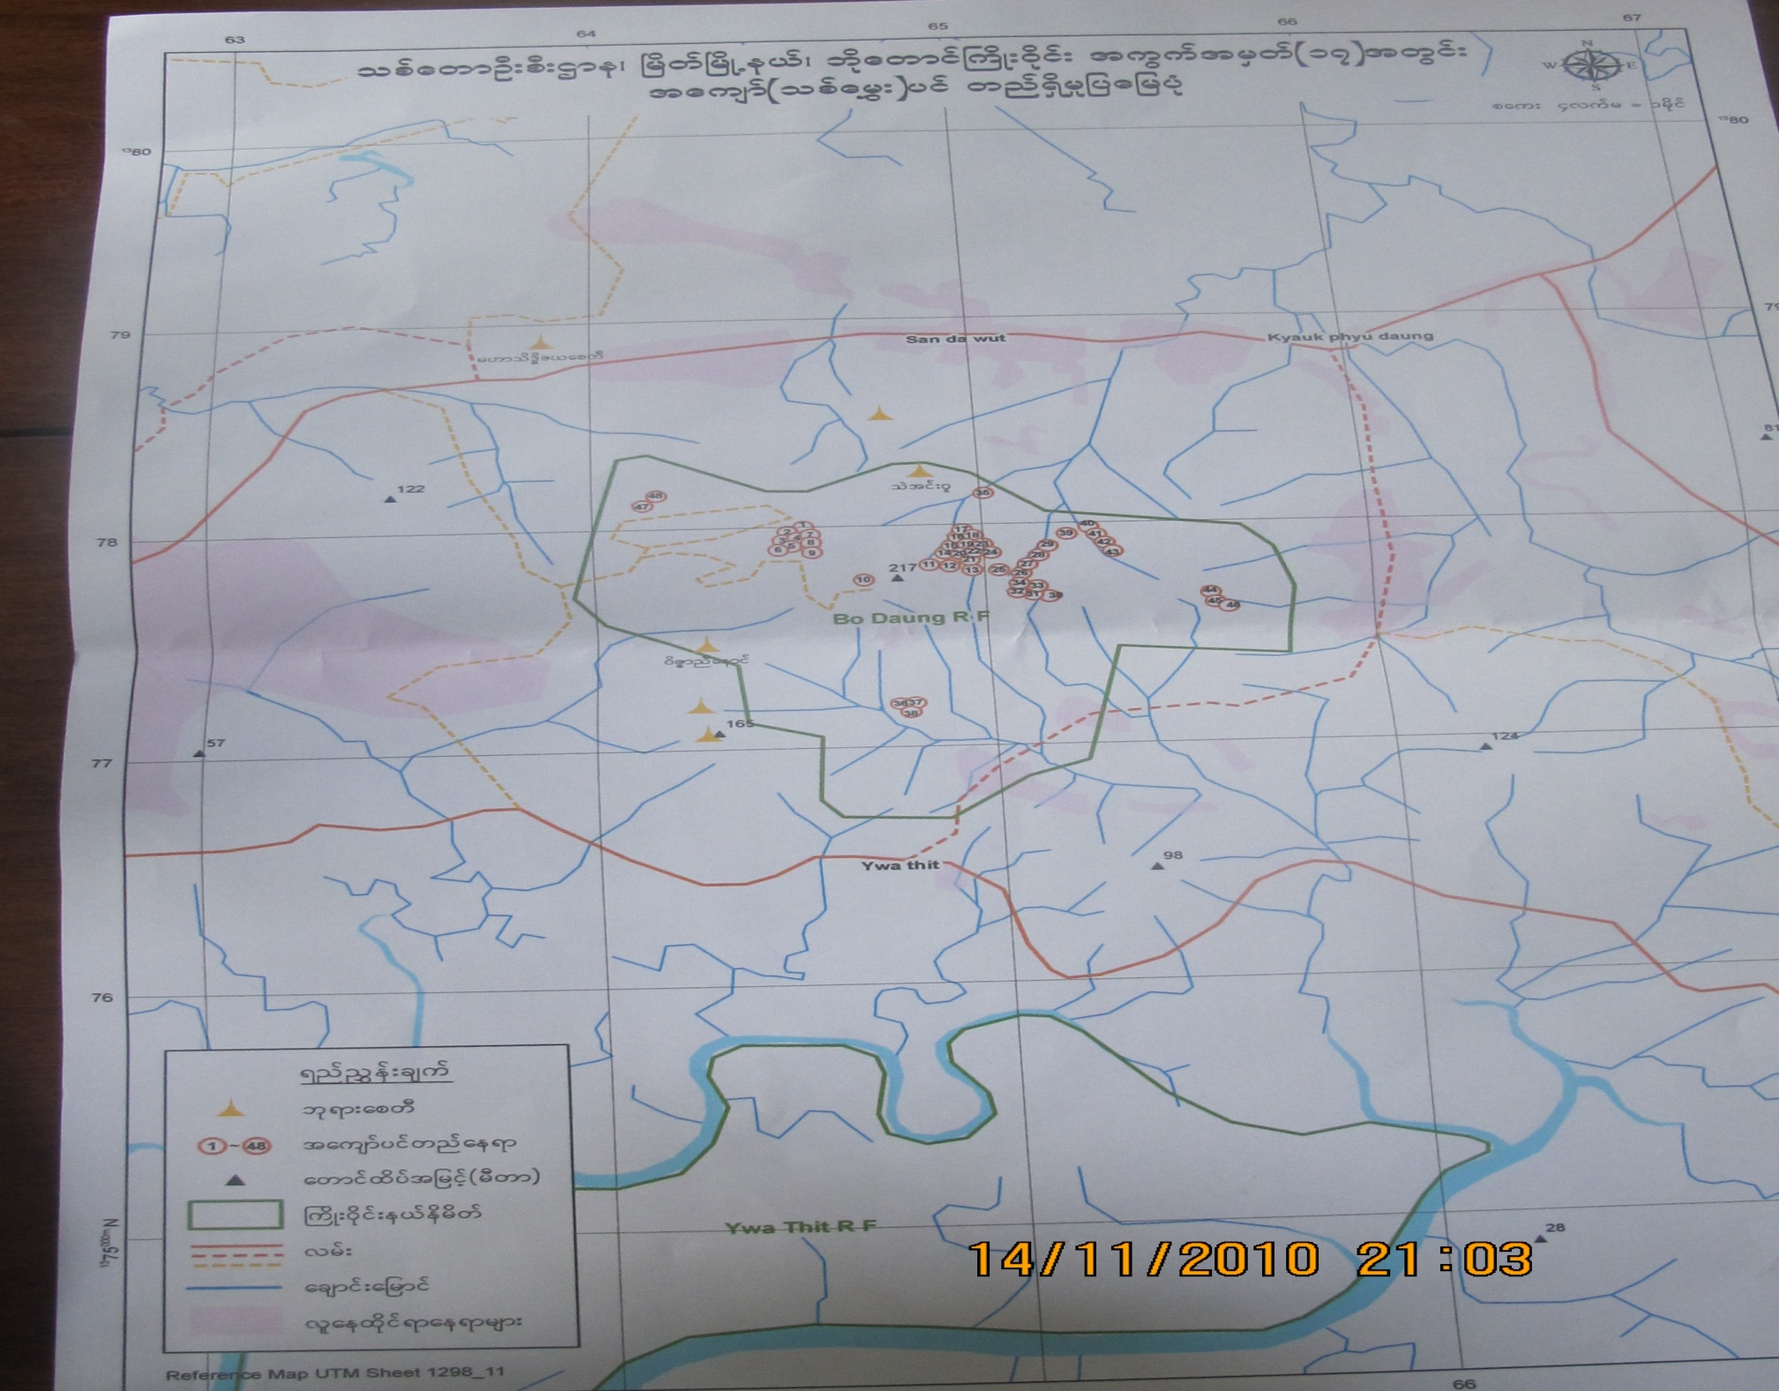

Slide 42
Thank You All !

